Slide 1
Mid Term Study Guide
Career Preparedness 2014

Slide 2
Hardware
Parts of the computer you can touch
Includes:
input devices – enter data
mouse, keyboard, microphone, scanner
output devices – display data
monitor, printer, speakers
storage devices – store data
CPU
flash drive
SD card

Slide 3
Information Processing Cycle
Input
Process
Output
Storage

Slide 4
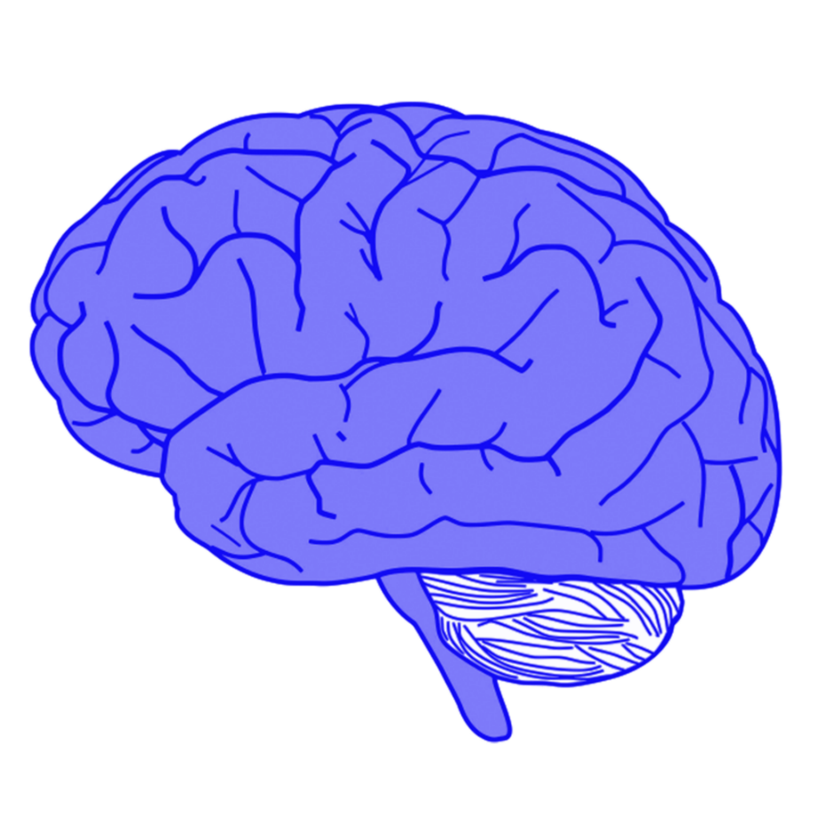
CPU
aka system unit or tower
processes the data
considered the BRAIN of the computer

Slide 5
Software
programs and/or applications that interpret instructions and tell the hardware what to do
operating system – main software program that controls the computer and makes it work
We are using Windows 7 in our classroom.

Slide 6
Decision making process
define the problem
gather information
list options
weigh/compare options
make decision
make plan of action
evaluate decision

Slide 7
GPA
grade point average
each letter grade is worth points:
A=4
B=3
C=2
D=1
F=0
add the points for each class, then divide by # of classes

Slide 8
Communication
CHANNELS of communication:
Verbal (oral)
Non-verbal
Written
Transferable skills – skills you can take from on job to another

